Slide 1
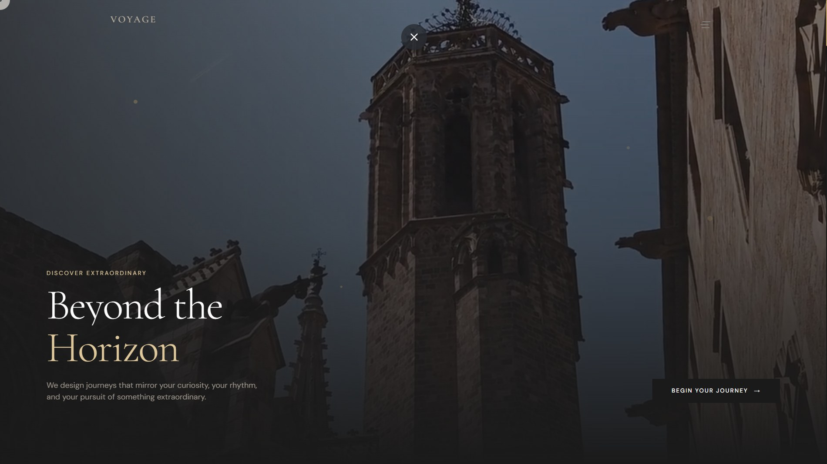

Curated Journeys
PROJECT PRESENTATION
A full-stack travel agency website built with Python and Django.
Presented by Aditya Ramesh Vispute
ITR · Computer Science and Engineering
Godavari College of Engineering and Polytechnic
Guide: Prof. Titiksha Zope
Notes:
Welcome everyone. This is VOYAGE, a travel agency web application I built with Django. Introduce yourself, your department, your college and your guide, Prof. Titiksha Zope.

Slide 2
Project Overview
INTRODUCTION
A database-driven travel agency website for exploring destinations and tours.
Travellers can register, book a curated or personalised trip and follow its status.
Django powers the backend; HTML, CSS and JavaScript shape the experience.
The VOYAGE homepage: a cinematic hero with a clear call to action.
VOYAGE · CURATED JOURNEYS
02 / 20
Notes:
VOYAGE brings destination discovery, tour packages, booking and user accounts into one premium-looking website. The data lives in a database and Django connects it to the pages.

Slide 3

Problem Statement
INTRODUCTION
Scattered information
Hard to choose
Travel details are spread across many platforms.
Travellers need an easy way to explore destinations and tours.
THE SOLUTION
VOYAGE
Unorganised bookings
Generic interfaces
One platform to discover, book and manage trips.
Booking details and preferences need one clear home.
Ordinary sites lack a consistent, engaging experience.
VOYAGE · CURATED JOURNEYS
03 / 20
Notes:
The problem: planning a trip means jumping between sites. VOYAGE answers that with one place for discovery, booking and account management.

Slide 4





Project Objectives
INTRODUCTION
Build a functional travel agency website
Display destinations and tour packages
Support accounts and booking workflows
Manage website data through Django
Deliver a consistent, premium experience
VOYAGE · CURATED JOURNEYS
04 / 20
Notes:
Five objectives: a working site, destination and tour pages, accounts and bookings, data managed through Django, and a premium user experience.

Slide 5
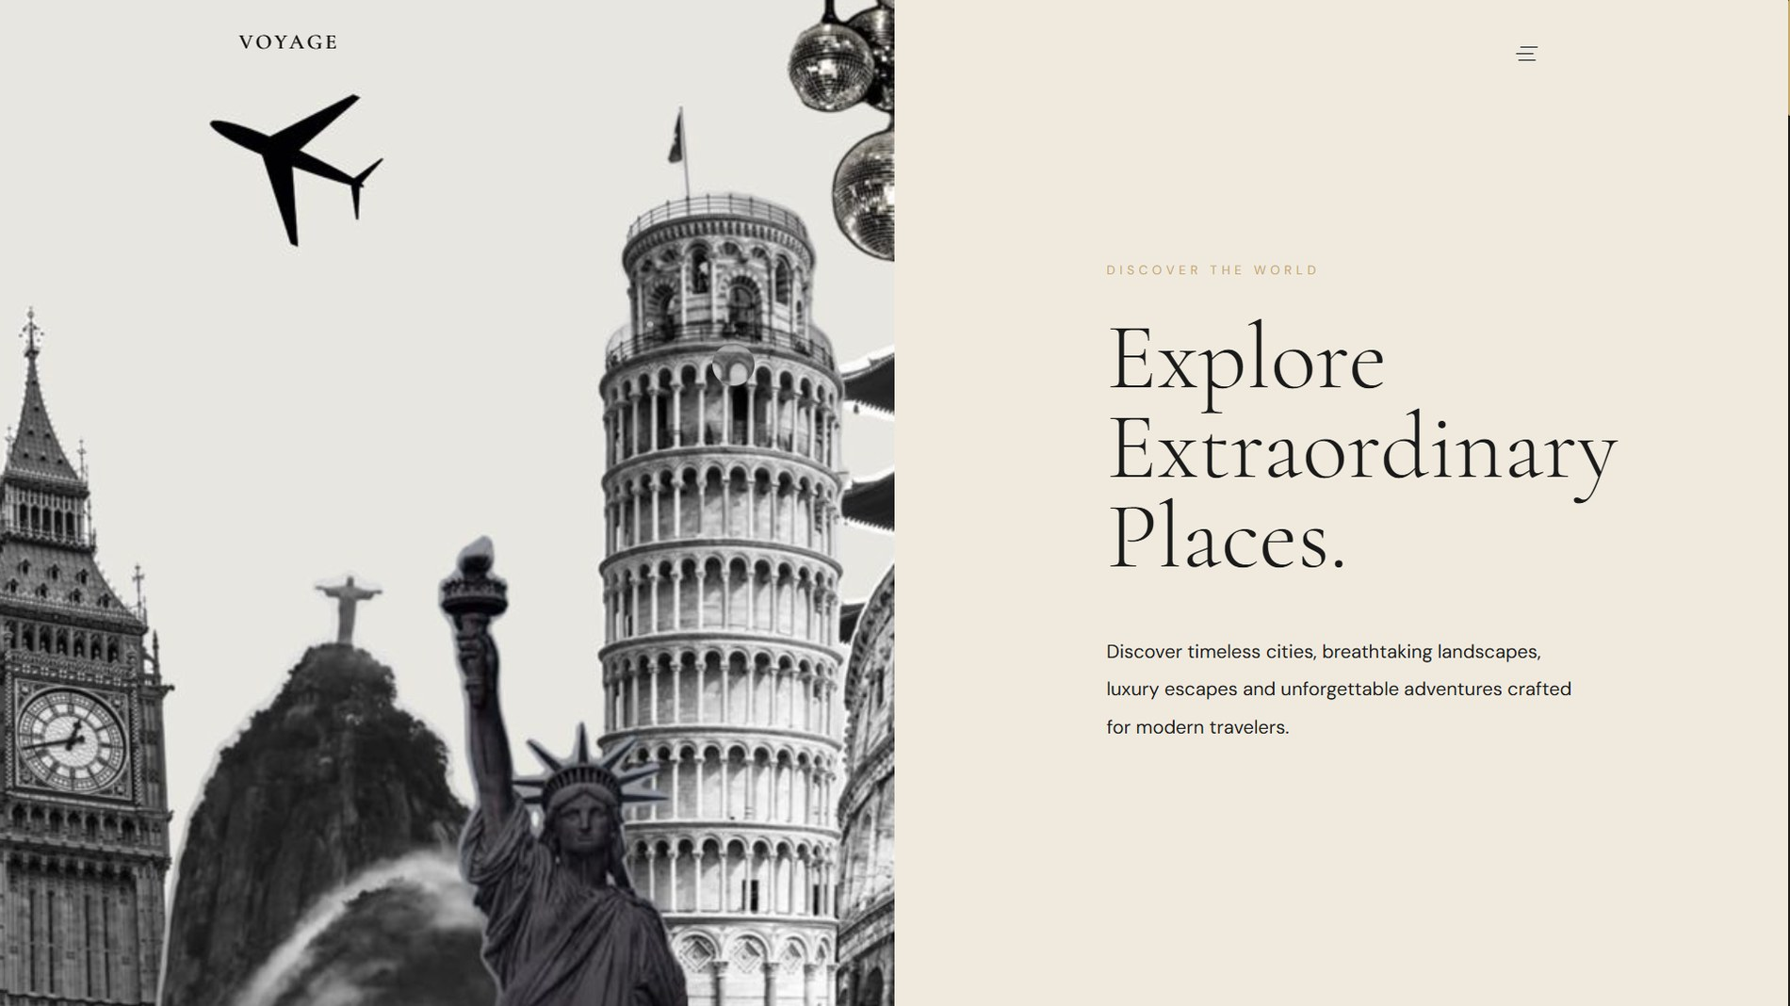
Brand Identity and Design Philosophy
INTRODUCTION
Luxury travel positioning: discovery should feel premium.
Elegant serif headlines with clean sans-serif body text.
Large photography and editorial page composition.
Ivory · gold · sand · charcoal
VOYAGE · CURATED JOURNEYS
05 / 20
Notes:
The brand is warm ivory, muted gold and charcoal, with elegant serif type. Everything on the site follows the same visual language.

Slide 6
Project Scope and Requirements
HOW IT IS BUILT
For travellers
For administrators
Browse destinations and tours
Manage destinations and tours
Register, log in and manage a profile
Review and update bookings
Book a curated or personalised journey
Edit site content and contact details
Follow payment and booking status
Maintain testimonials, blogs and experiences
Leave reviews and ratings
All handled in the Django Admin panel
VOYAGE · CURATED JOURNEYS
06 / 20
Notes:
Requirements split into two groups: what a traveller can do on the site, and what an administrator can manage through the Django Admin panel.

Slide 7
Technology Stack
HOW IT IS BUILT
Python
Django
HTML
CSS
Main programming language
Routing, views, forms, auth and admin
Page structure and templates
Styling, layout and effects
JavaScript
SQLite
Django ORM
Git and GitHub
Interactive components
Relational database
Python models talk to the database
Version control
VOYAGE · CURATED JOURNEYS
07 / 20
Notes:
A conventional full-stack setup. Django is the core: it connects the interface to the database and provides routing, authentication, forms and the admin.

Slide 8


System Architecture
HOW IT IS BUILT
01
02
03
04
05
Browser
URLs
Views
Models
SQLite
Opens a page or submits a form
Route the request to a view
Validate forms and apply logic
Read and write through the ORM
Stores the application records
Response: Django renders a template with the data, and the browser shows it with CSS and JavaScript.
VOYAGE · CURATED JOURNEYS
08 / 20
Notes:
Walk through a request: the browser asks for a page, Django routes it to a view, the view uses models to read or write the database, a template renders the HTML, and the browser displays it. A booking also validates form data before creating records.

Slide 9
Django Project Structure
HOW IT IS BUILT
VOYAGE/
config/
Settings and project routing
apps/
Django applications
Separate apps keep features apart.
core/
Destinations, tours, site content
Templates hold the HTML; static files hold CSS and JavaScript.
booking/
Booking and payment logic
templates/
HTML pages
static/
CSS, JavaScript, images
manage.py
Django command-line tool
VOYAGE · CURATED JOURNEYS
09 / 20
Notes:
This is the layout of the project. Tip: you can replace this diagram with a screenshot of your VS Code explorer if you prefer to show the real folders.

Slide 10


Database Design and Models
HOW IT IS BUILT
Destination
Tour
Booking
User
Location, description, images and details
1 : N
Price, duration, itinerary and seats
1 : N
Traveller details, dates, preferences, booking and payment status
1 : N
Django account, profile and journeys
1 : N
The Django ORM maps each model to a database table.
Site content models
Review
SiteSettings · Experience · Testimonial · Blog
Rating and traveller story for a booking
VOYAGE · CURATED JOURNEYS
10 / 20
Notes:
High-level model diagram. Before presenting, check the relationships and the Review model against models.py, and replace this slide with your own ER diagram if you have one.

Slide 11
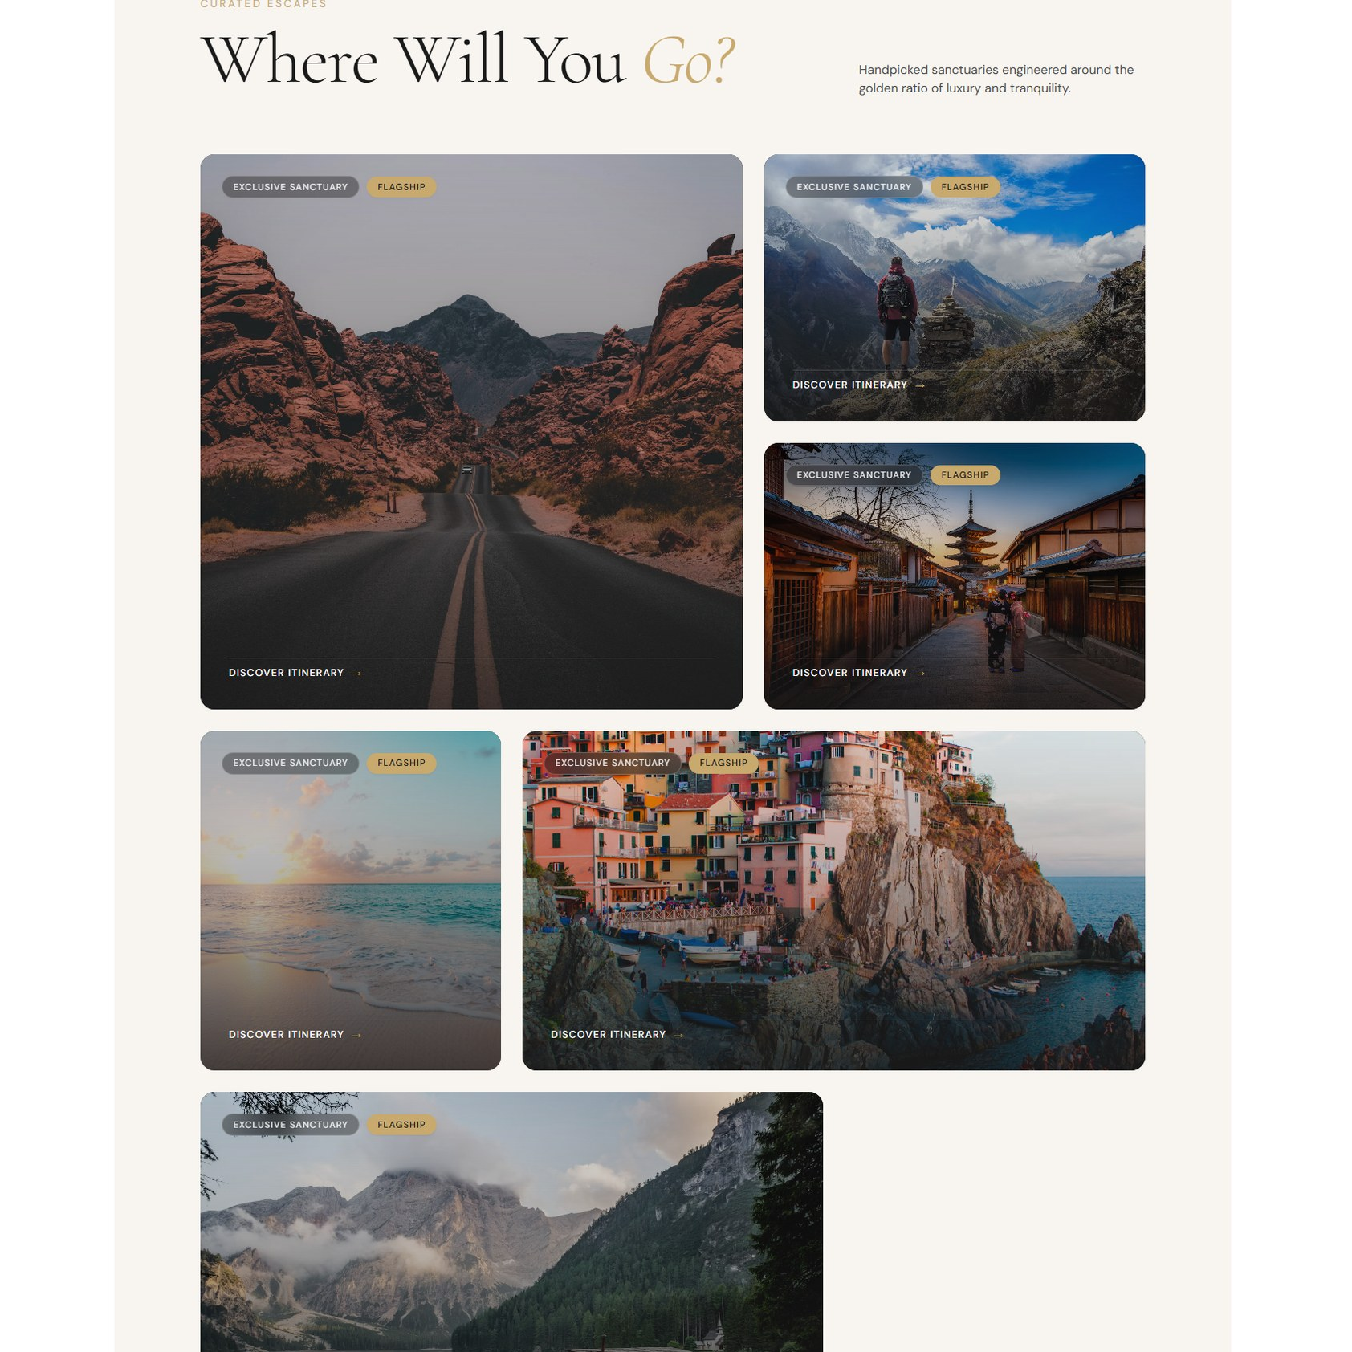
Homepage and Website Experience
THE WEBSITE
A cinematic hero, a clear call to action and a curated destination grid.
VOYAGE · CURATED JOURNEYS
11 / 20
Notes:
Live demo cue: open the homepage. Point out the hero, the Begin Your Journey call to action, the navigation, the featured destinations grid and the footer.

Slide 12
Destination Discovery
THE DESTINATION PAGE
Visual browsing of destinations
Editorial layout with a landmark collage
Detail pages with photos and information
The destinations page opens with an editorial split layout.
VOYAGE · CURATED JOURNEYS
12 / 20
Notes:
Destinations come from the database, so adding one in Django Admin makes it appear on the site. Mention search and filtering only if they work in your build.

Slide 13
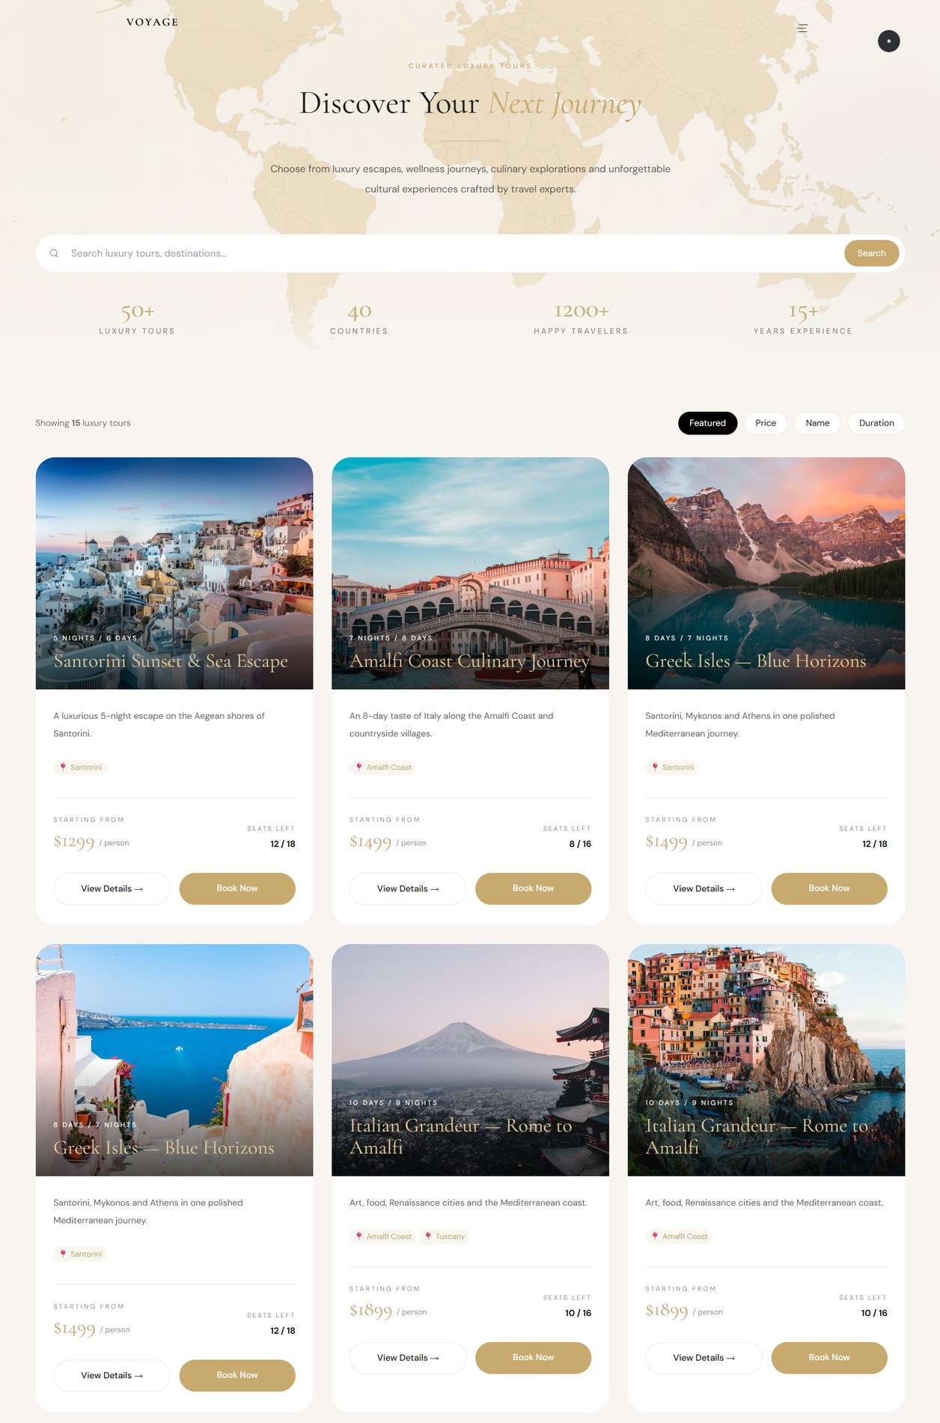
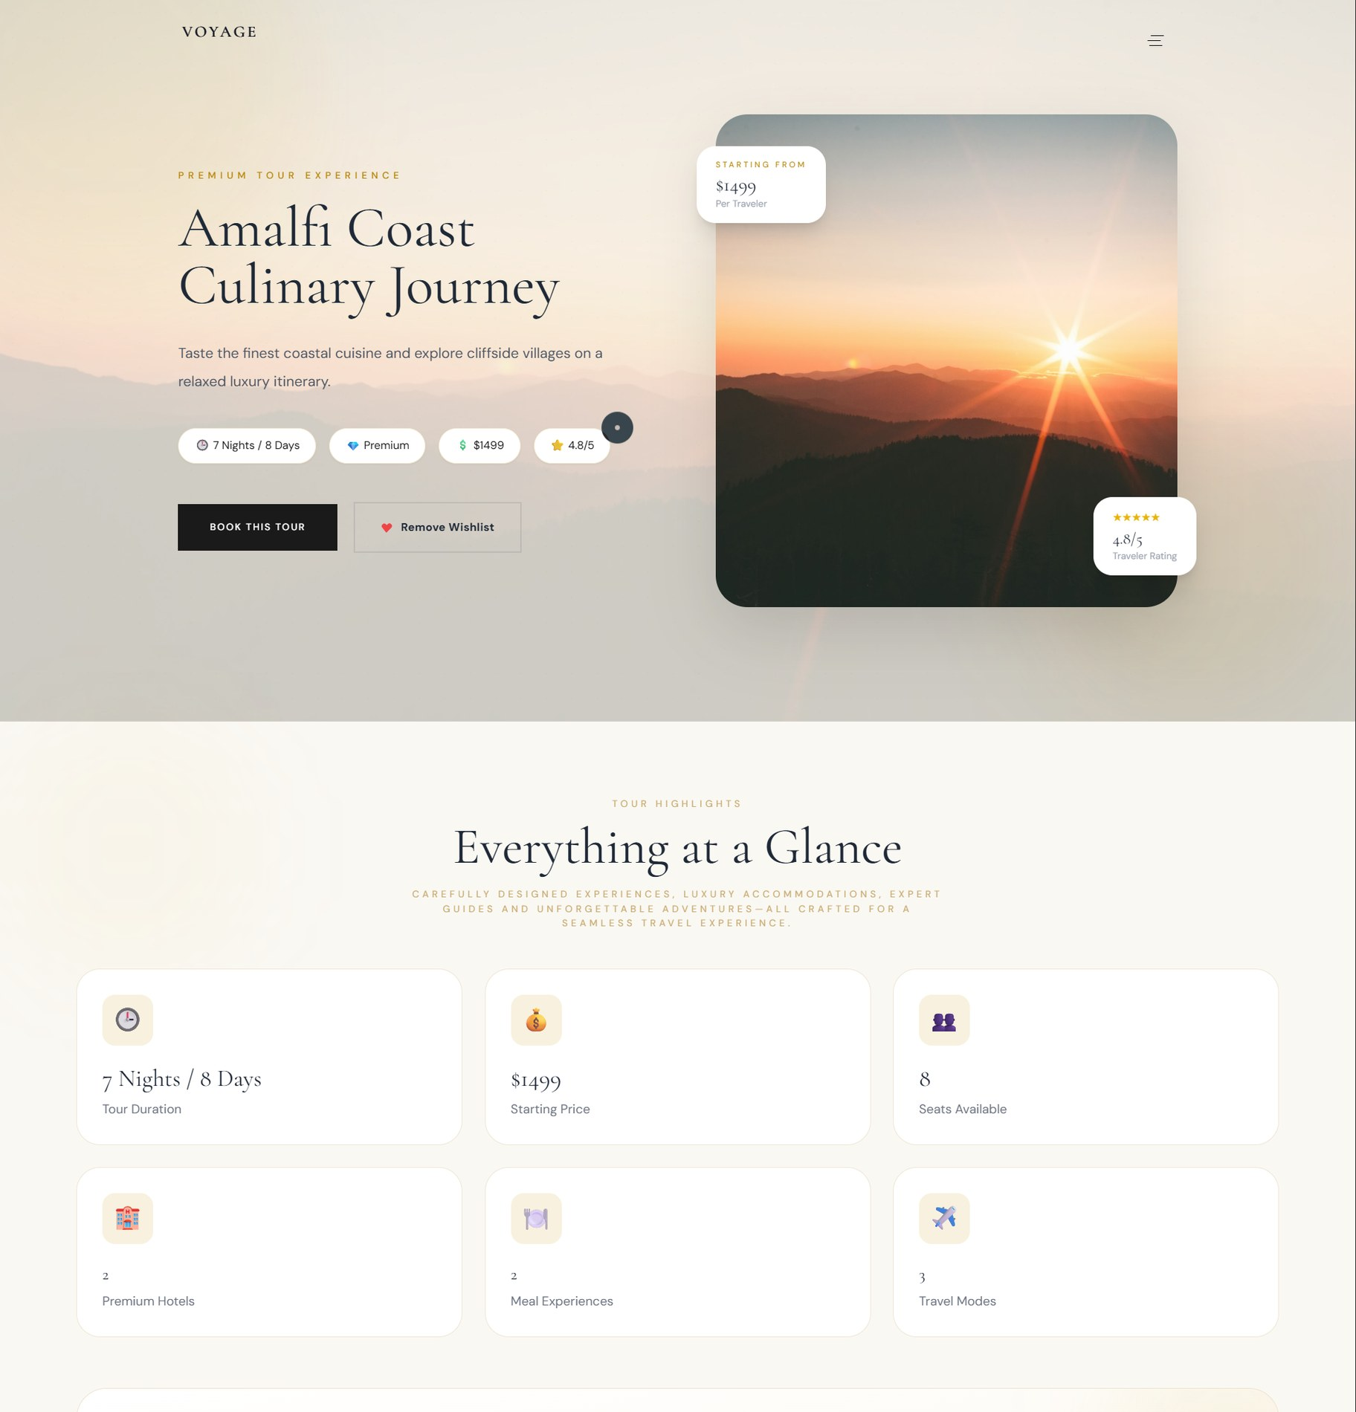
Tours and Travel Experiences
THE TOURS PAGE
Tour cards with price, duration and seats left
Detail pages with a day-by-day timeline
Book now and wishlist actions
Tour listing
Amalfi Coast Culinary Journey
VOYAGE · CURATED JOURNEYS
13 / 20
Notes:
Each tour card shows the starting price, nights and days, and seats left. The detail page adds highlights and a day-by-day journey timeline, then leads into booking.

Slide 14
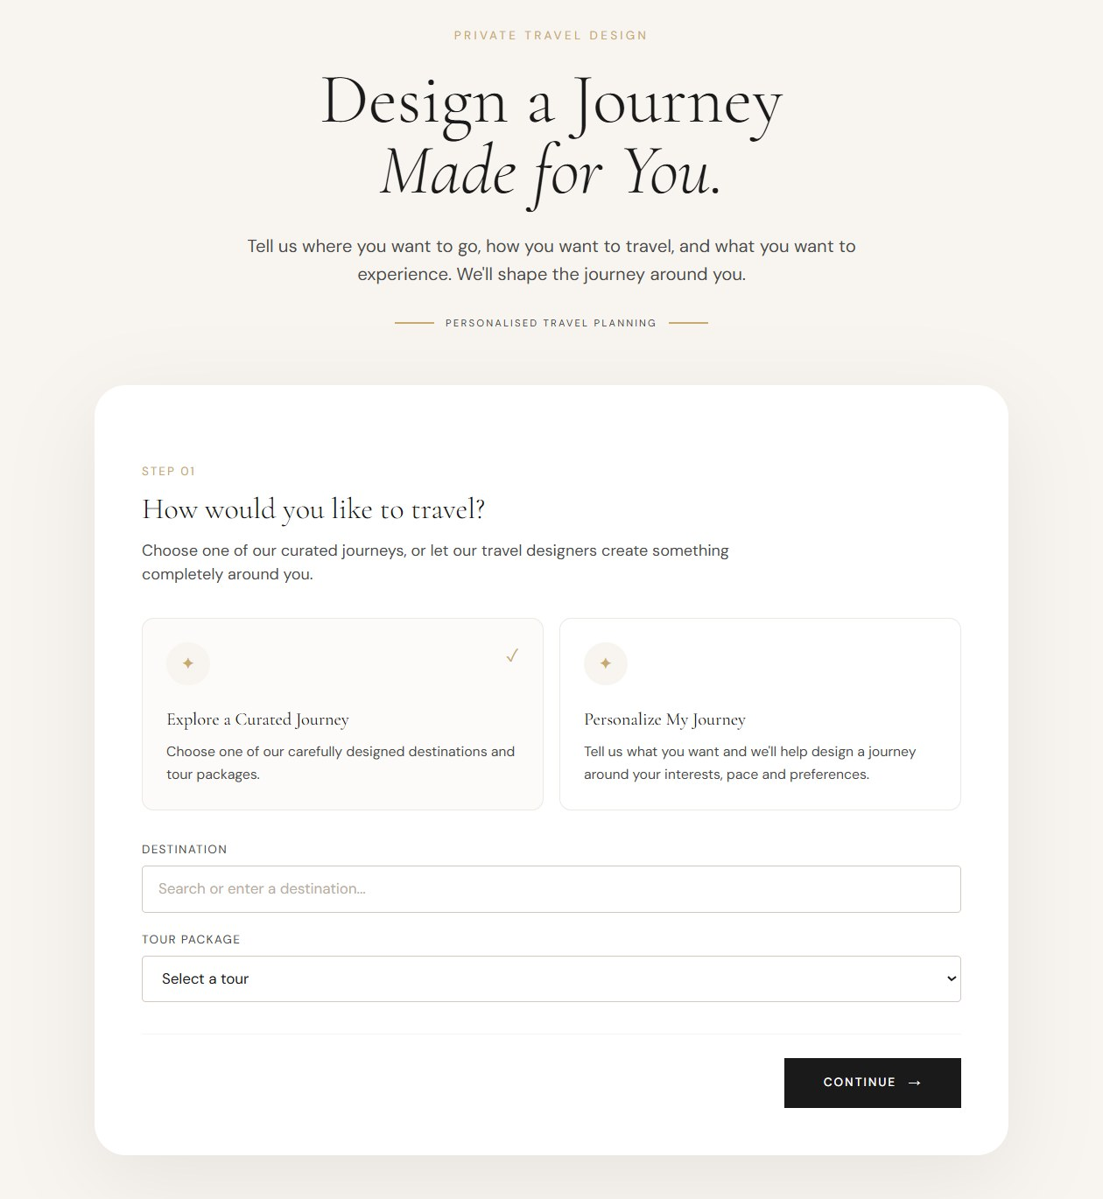
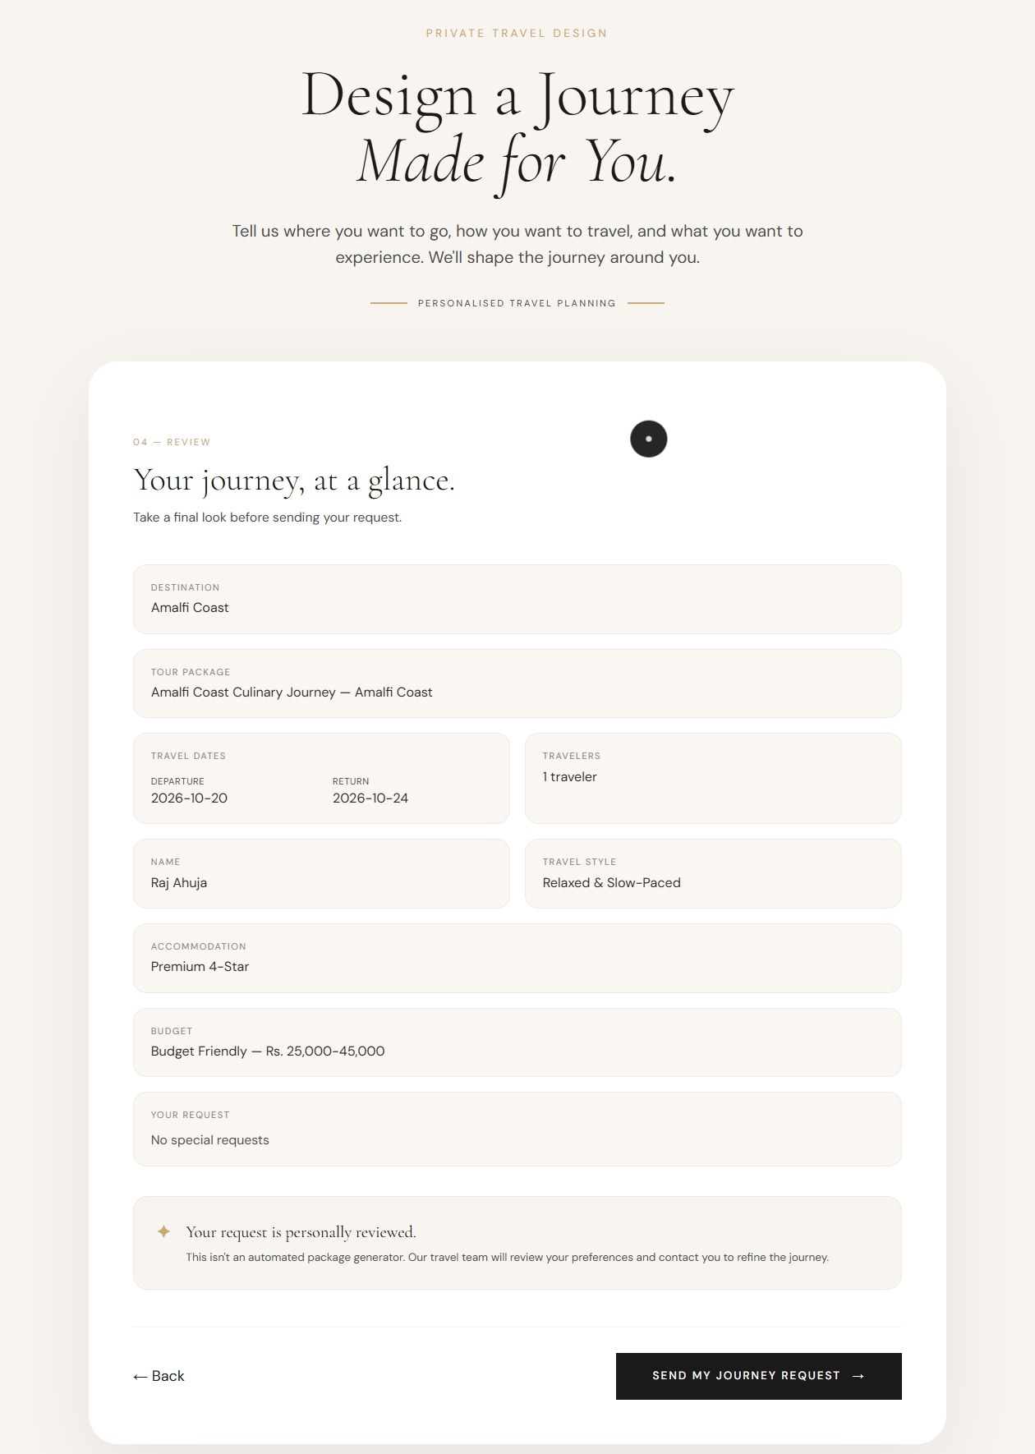
Booking and Trip Personalization
CHOOSING THE JOURNEY
Choose a curated tour or a personalised journey
Capture dates, travellers, style and budget
Review everything before sending
Step 1: choose how to travel
Final review step
VOYAGE · CURATED JOURNEYS
14 / 20
Notes:
The booking form is a guided multi-step flow. Django validates the submission and stores the booking in the database.

Slide 15
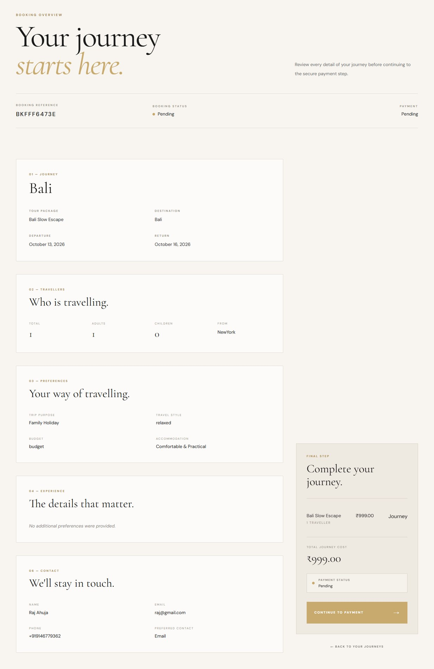
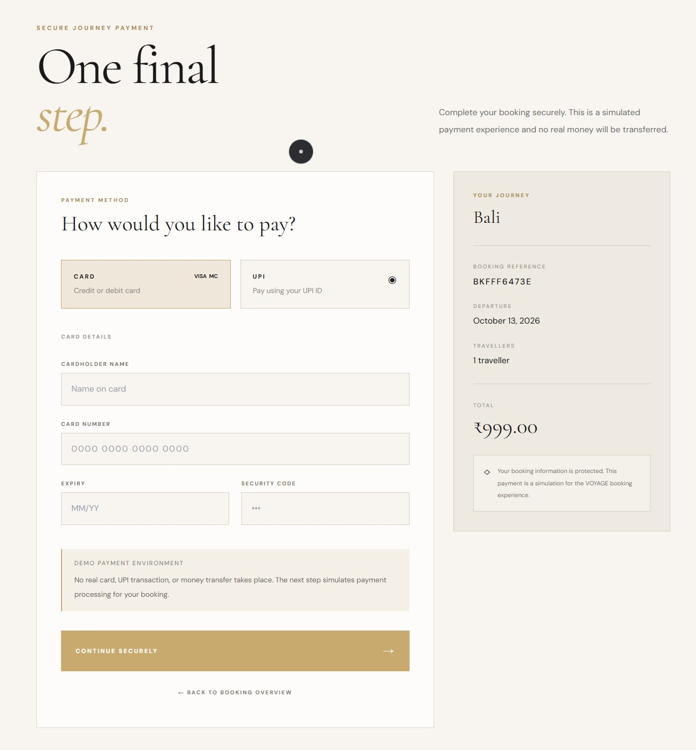

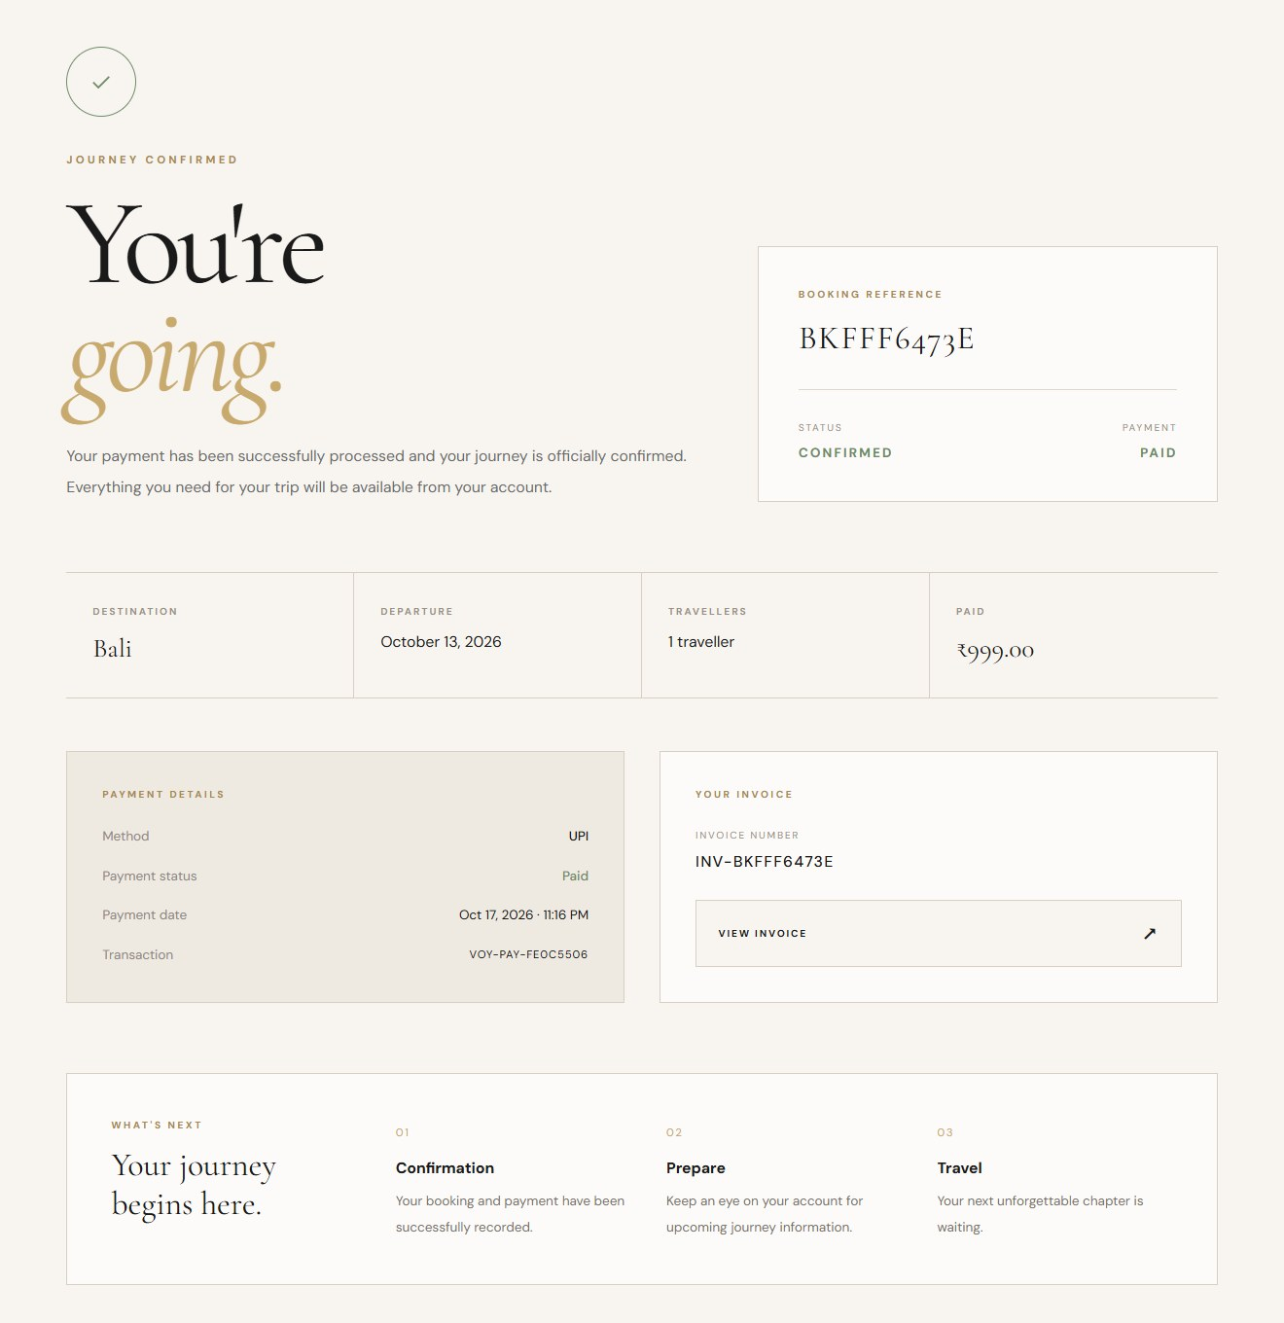
Payment and Booking Confirmation
PAYMENT & BOOKING FLOW
A simulated payment workflow: no real money is transferred.
1 · Booking overview
2 · Payment method
3 · Verifying payment
4 · Journey confirmed
VOYAGE · CURATED JOURNEYS
15 / 20
Notes:
The booking moves from pending to confirmed: overview, payment, verification and confirmation with a booking reference and invoice. The payment is a simulation; a real gateway is future scope.

Slide 16
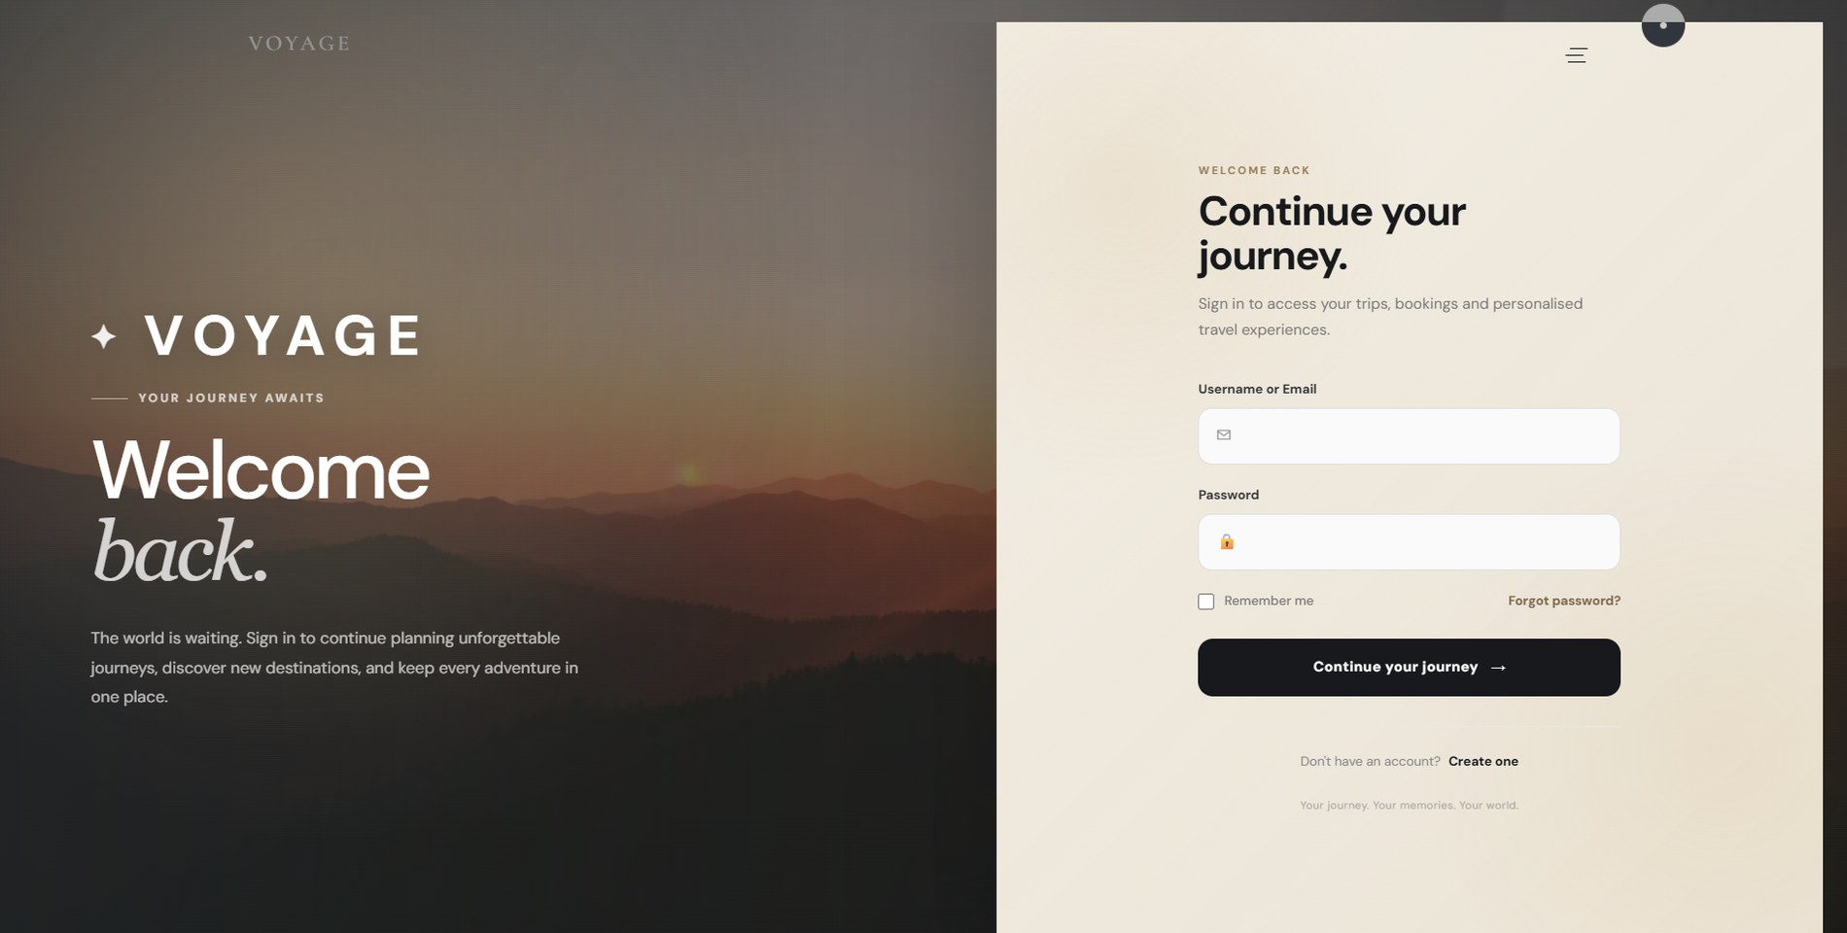
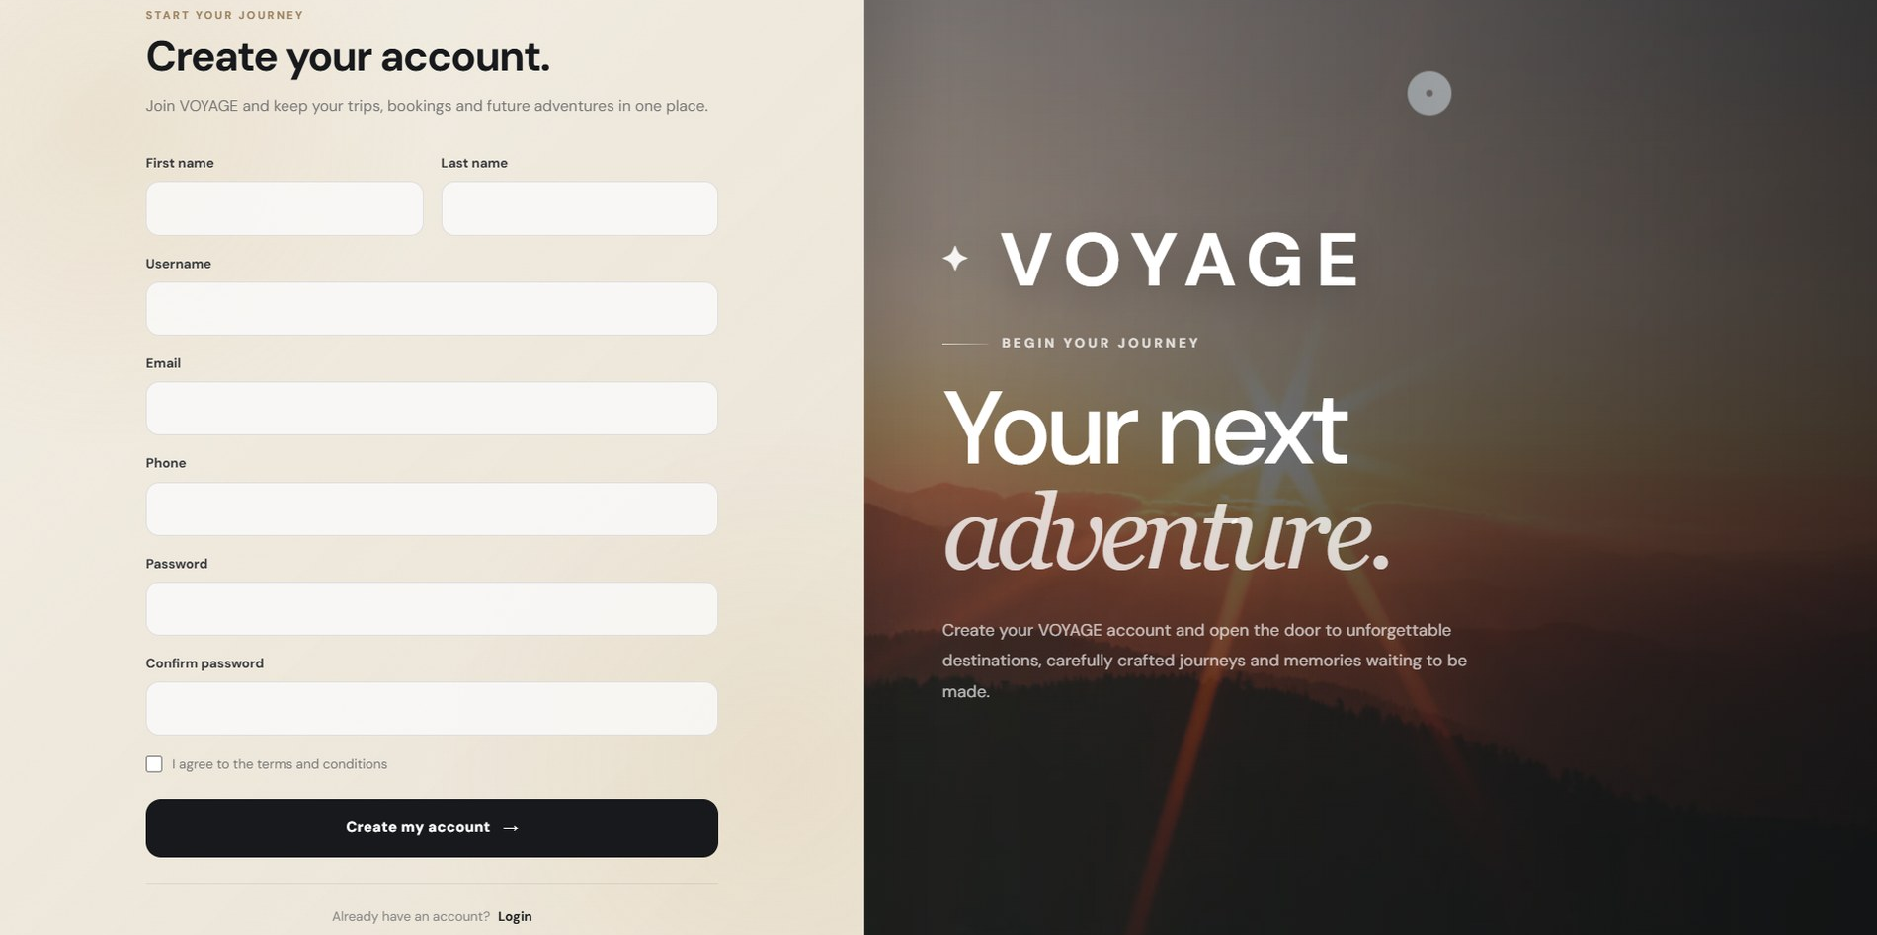
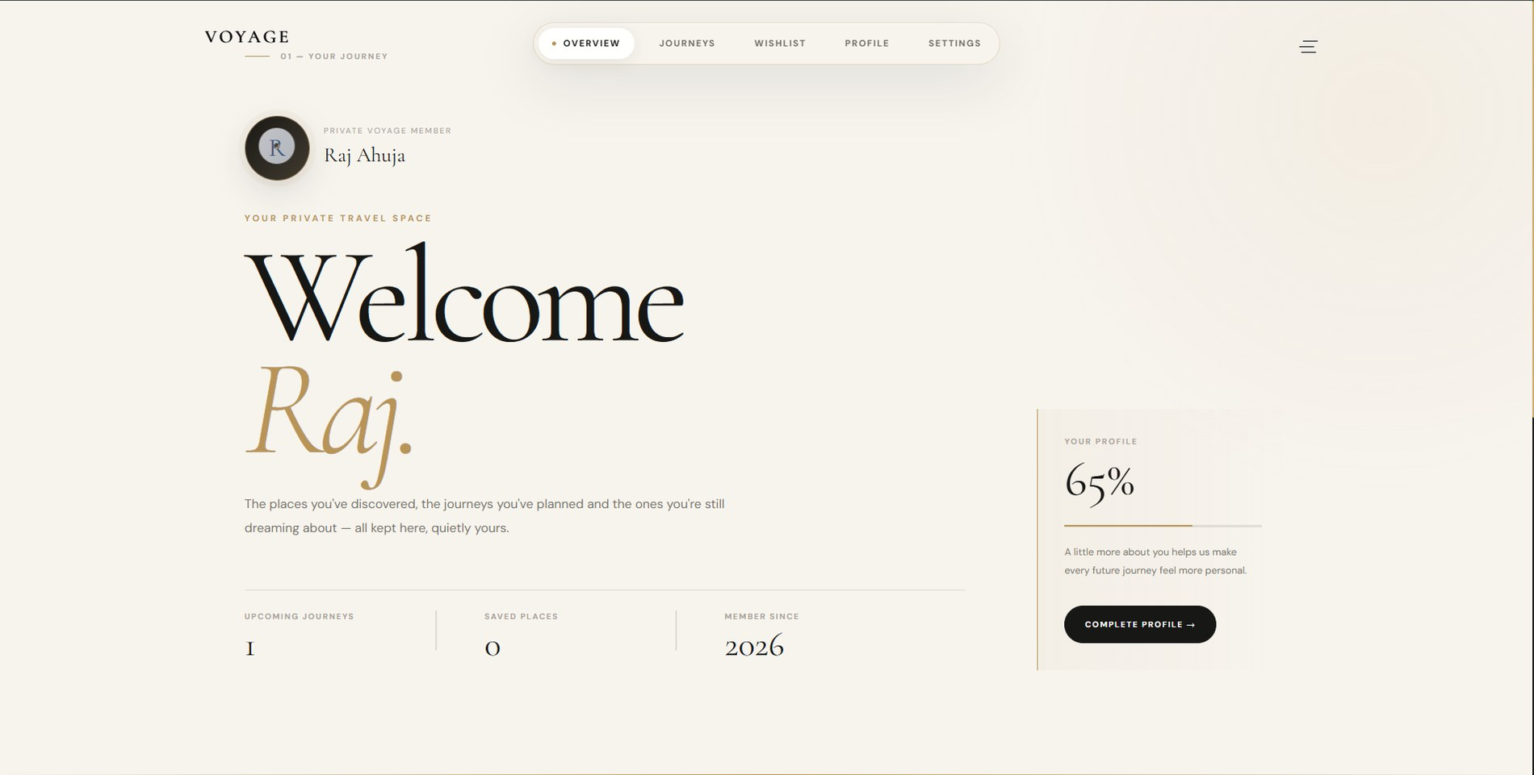
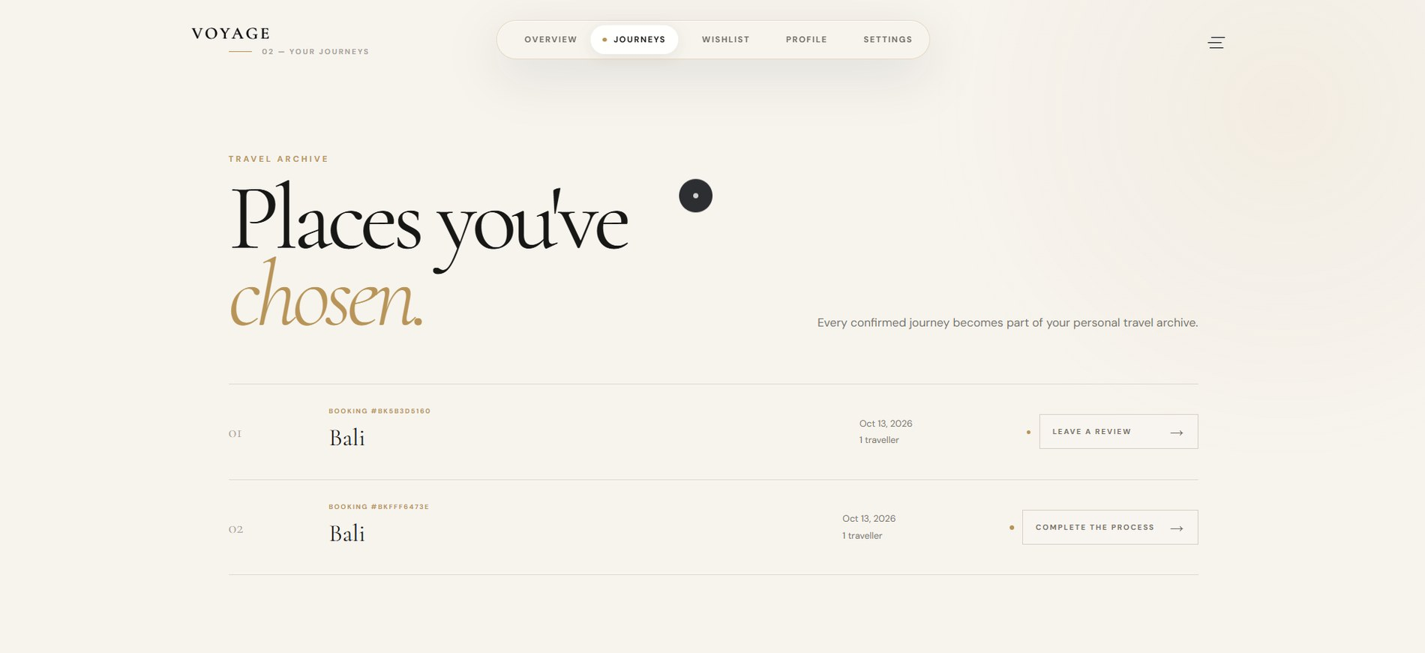
User Accounts and Trip Management
USER ACCPOMTS & PROFILE
Login
Registration
Registration and login
Profile and booking history
Journey archive with reviews
Profile overview
Journey timeline
VOYAGE · CURATED JOURNEYS
16 / 20
Notes:
Users register and log in, then see a private profile with their journeys. Each confirmed booking appears in the journey archive, with a button to leave a review.

Slide 17
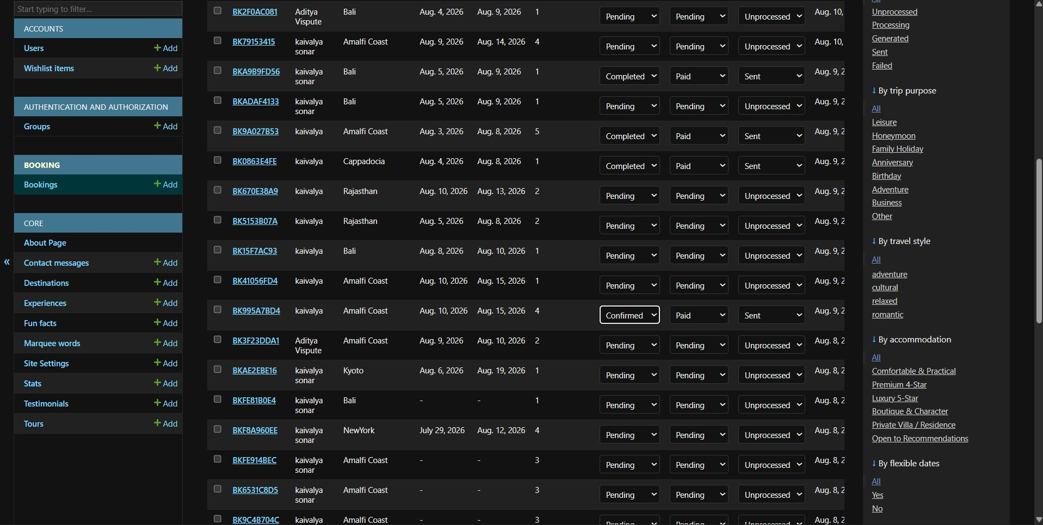
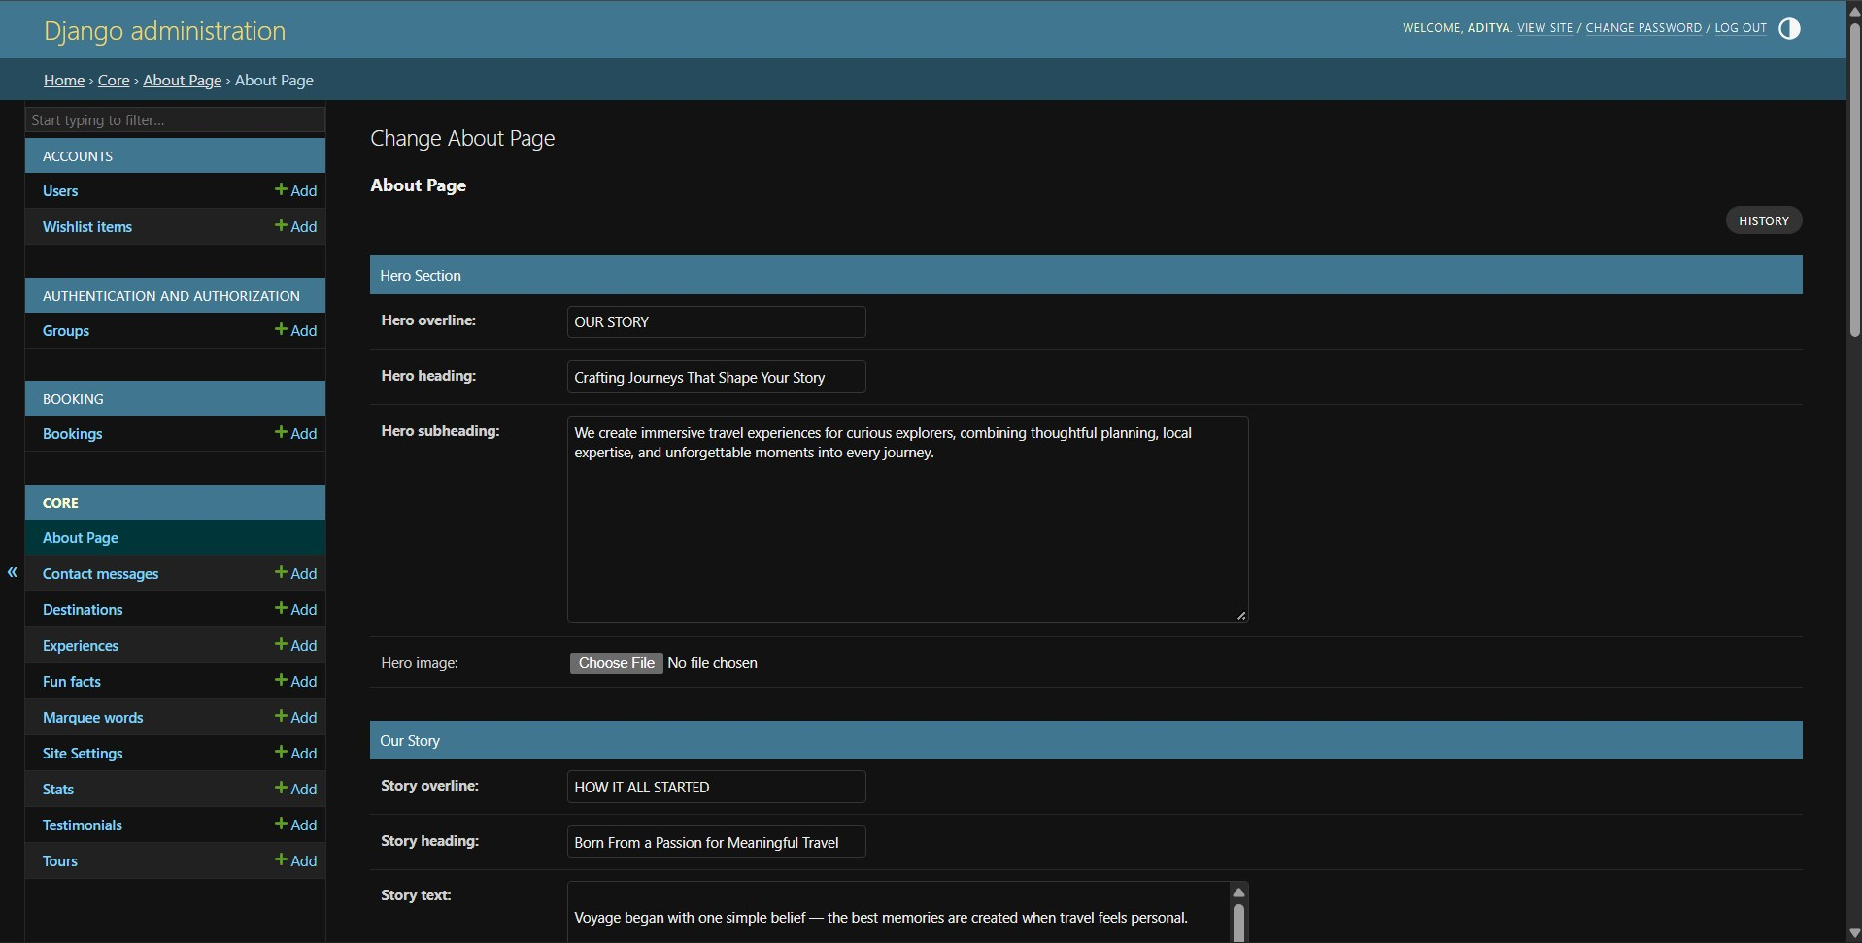
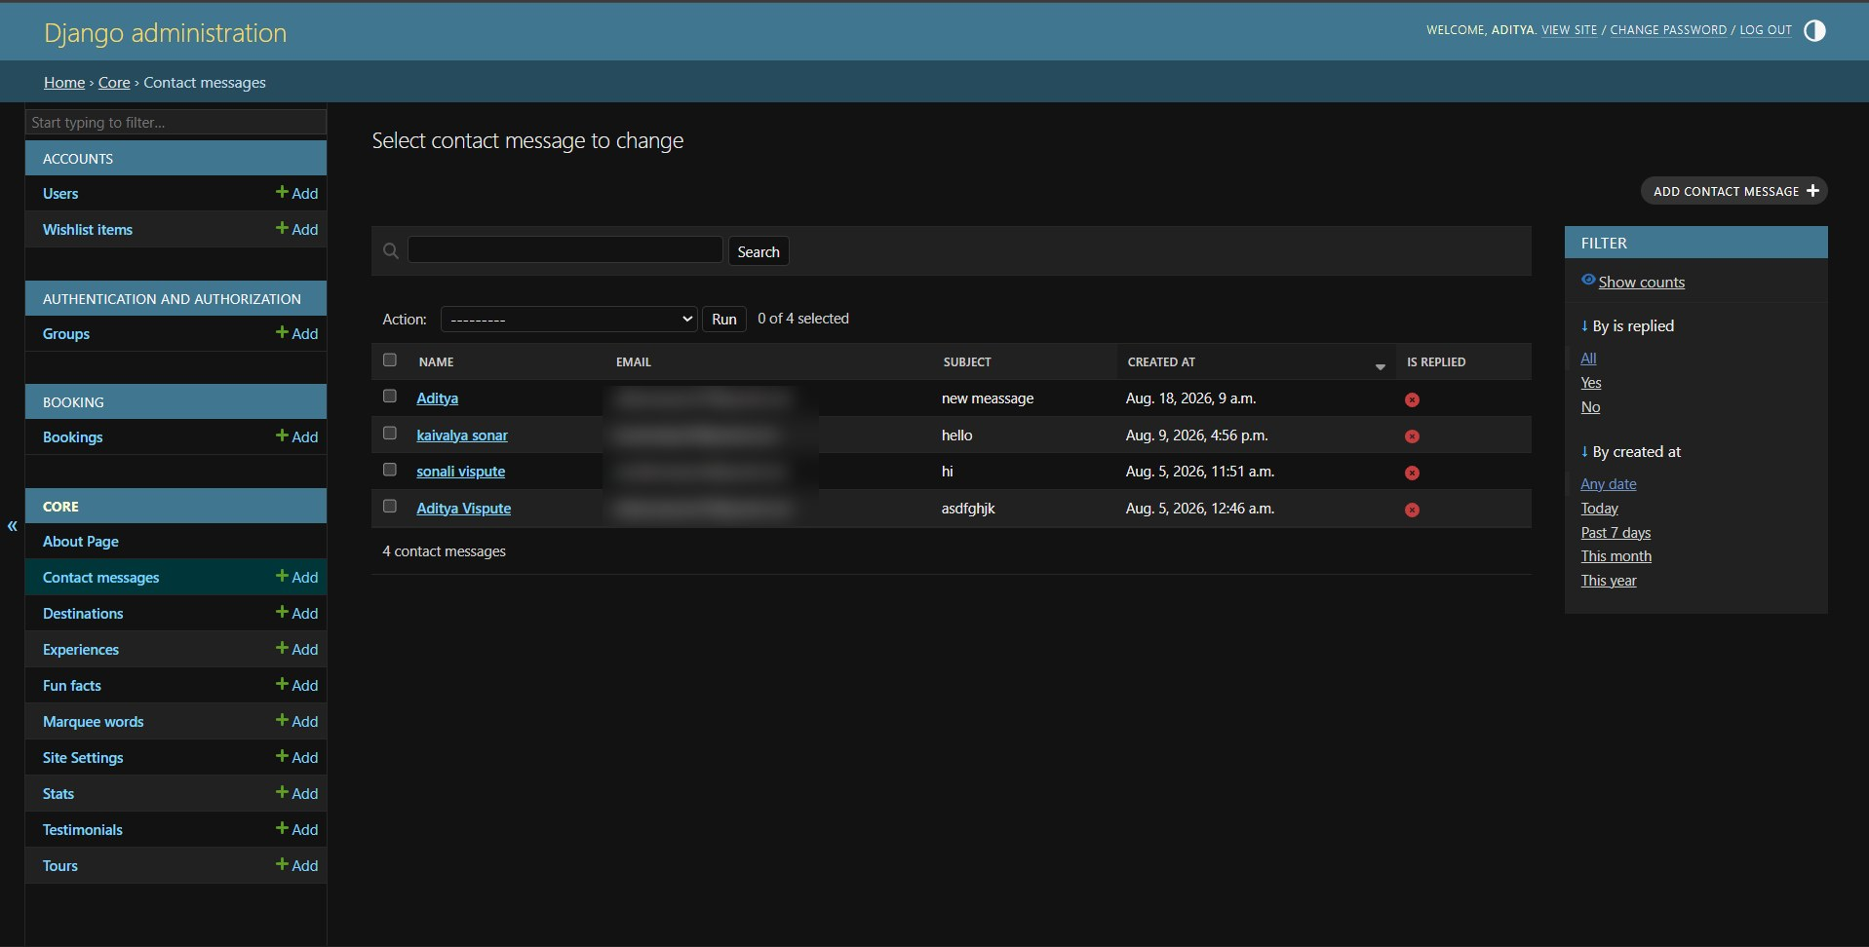
Backend Administration
ADMIN PANEL
Update booking and payment status from one list
Edit the About page and site content without code
Read contact messages from travellers
Django’s built-in admin, managing 14 models including Users, Bookings, Destinations and Tours.
VOYAGE · CURATED JOURNEYS
17 / 20
Notes:
Top: the Bookings list, where booking, payment and invoice status can be changed from dropdowns. Bottom left: the About page is edited as a form, so site text changes without touching code. Bottom right: contact form messages arrive here. This is Django’s built-in admin, not a custom dashboard. Demo cue: open /admin/, edit a tour, then change a booking status.

Slide 18
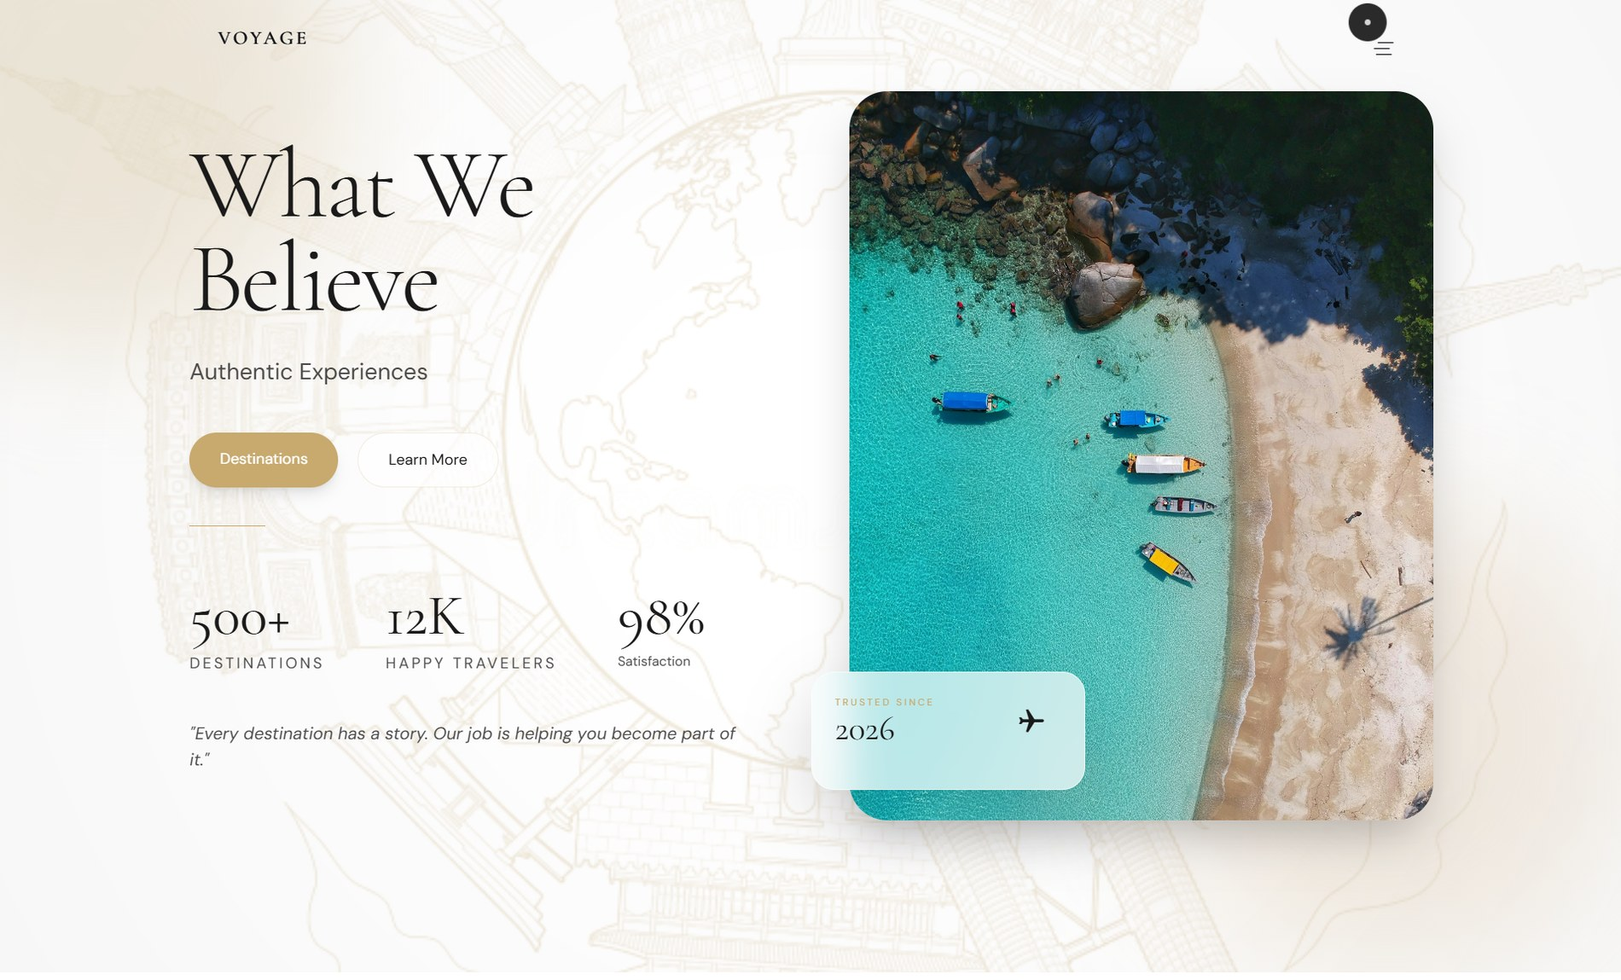
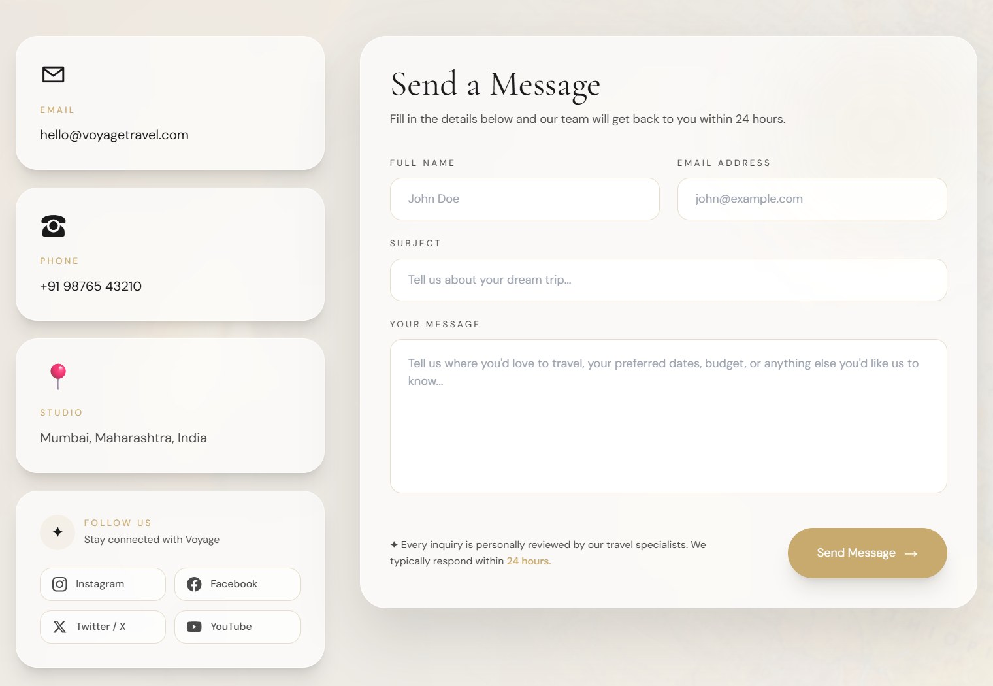
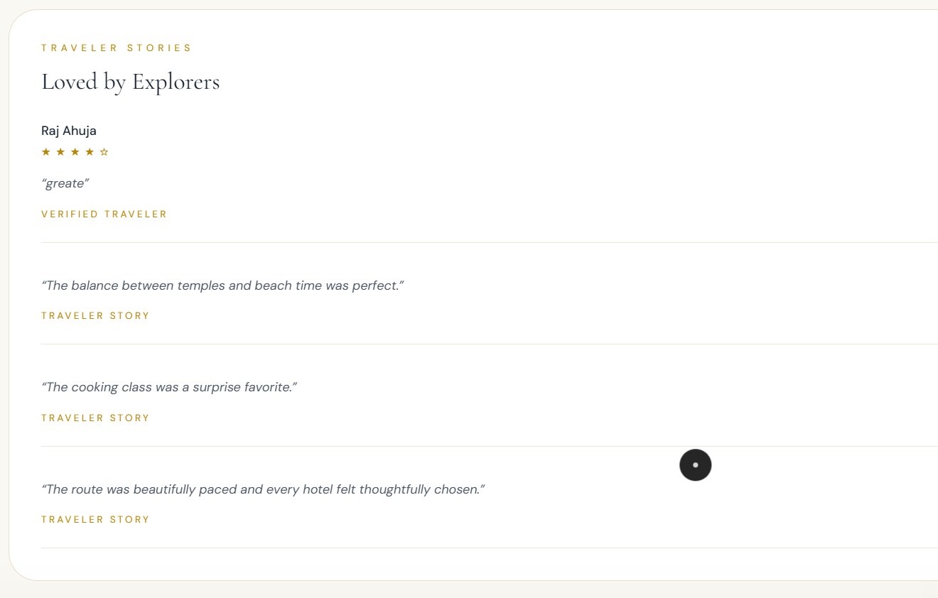
UI/UX Design and Supporting Pages
DESIGEN AND LOOKS
About
Contact
Reviews
Brand story, mission and core values
An enquiry form with contact details
Star ratings and traveller stories
VOYAGE · CURATED JOURNEYS
18 / 20
Notes:
Consistent typography, spacing and colour tie every page together. The supporting pages (About, Contact and Reviews) follow the same visual language as the booking flow.

Slide 19



Testing, Challenges and Future Scope
Tested
Challenges
Future scope
Full flow: tour, booking, payment, confirmation
Separating booking status from payment status
Real payment gateway and email notifications
Booking and payment status at each step
One premium design across many pages
Automated tests and production deployment
Journeys and reviews shown on the profile
Modelling a multi-step booking in Django
Smarter trip planning and booking reports
VOYAGE · CURATED JOURNEYS
19 / 20
Notes:
Only claim the checks you actually ran. The flow shown in the screenshots worked end to end. Future scope items are not implemented yet.

Slide 20
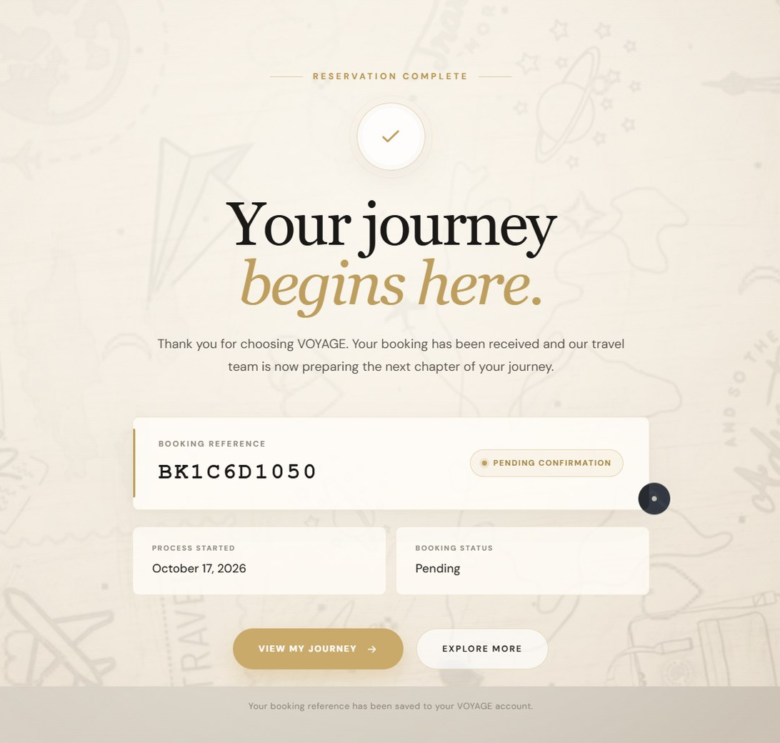
Thank You Questions?
CONCLUSION
A full-stack travel agency website built with Django
Discovery, booking and accounts on one platform
Next: a real payment gateway and automated tests
VOYAGE · CURATED JOURNEYS
20 / 20
Notes:
To close: VOYAGE combines frontend design, Django, database management and booking workflows in one project. Add a sentence on what you learned and what you would improve next, then take questions.

